Slide 1


Meta Tag Understanding <meta> Tag and Its Attributes
Prepared by: MORESH LONDE

Slide 2


What is a Meta Tag?
Metadata is data (information) about data.
The <meta> tag defines metadata about an HTML document.
Meta tags provide information about a webpage.
They are written inside the <head> section.
They are not displayed on the webpage.
They help browsers, search engines, and other applications understand the page.
Syntax
<meta attribute="value">

Slide 3

Attributes of Meta Tag
Attribute | Purpose
name | Specifies the type of metadata
content | Stores the metadata value
charset | Defines character encoding
http-equiv | Sends HTTP-style instructions to the browser

Slide 4
name
name → What kind of information is this?
content → What is the value of that information?
<meta name="author" content=“Moresh">
Specifies a name for the type of metadata.
It pairs directly with the content attribute.
Name | Describe
author | Defines the creator of the page content.
description | Provides a brief summary of the page
Keywords | Lists relevant terms
viewport: Controls how the page renders on mobile devices.

Slide 5
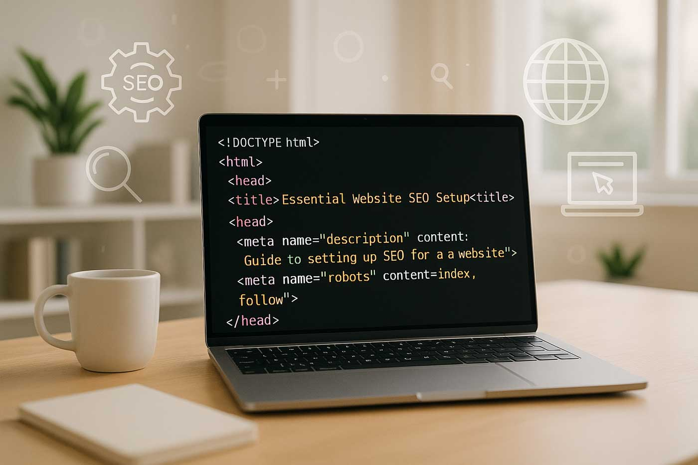
content
<meta name="description"
content="Learning HTML Meta Tags">
Holds the actual data or value.

Slide 6

charset
Declares the character encoding scheme for the entire HTML document.
This is called a character encoding declaration.

Slide 7
http-equiv
HTTP-equivalent
This attribute behaves like an HTTP response header and gives instructions to the browser.
Refresh | Refreshes or redirects the webpage
Set-cookies | setting cookies
Content-type | Specifies the document type and character encoding
expires | Indicates when cached content should be considered expired

Slide 8
<head>
<title>Meta Name & Content Attributes Demo</title>
<meta name="author" content="Moresh">
<meta name="description“
content="This webpage demonstrates the name and content attributes of HTML meta tags.">
<meta name="keywords“
content="HTML, Meta Tags, Name Attribute, Content Attribute,">
<meta name="copyright“
content="© 2026 Moresh sir ke Lectures">
</head>

Slide 9
<!DOCTYPE html>
<html>
<head>
<title>Meta Refresh Demo</title>
<meta http-equiv="refresh" content="5">
</head>
<body>
<h1>HTML Meta Refresh Example</h1>
<p>This page will automatically refresh after 5 seconds.</p>
</body>
</html>

Slide 10
<!DOCTYPE html>
<html>
<head>
<title>Old Set Cookie Demo</title>
<meta http-equiv="set-cookie"
content="Name=Moresh">
</head>
<body>
<h1>Meta Tag Set-Cookie Example</h1>
<p>
This page is trying to set a cookie using the meta tag.
</p>
</body>
</html>

Slide 11
<!DOCTYPE html>
<html>
<head>
<title>Content Type and Expires Demo</title>
<meta http-equiv="Content-Type"
content="text/html; charset=UTF-8">
<meta http-equiv="expires"
content="Wed, 01 Aug 2026 00:00:00 GMT">
</head>
<body>
<h1>Meta Tag Demo</h1>
</body>
</html>

